Slide 1
SoundPure — Frontend Website Screens
12 individual visual reference screens

Slide 2
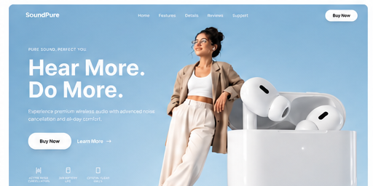
01 — Home / Hero

Slide 3
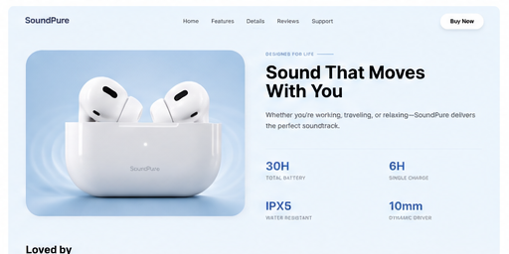
02 — Product Overview

Slide 4
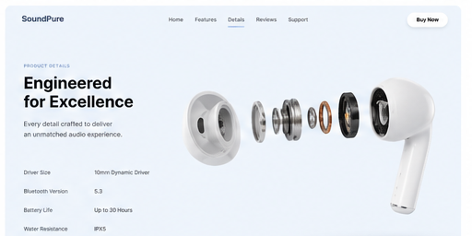
03 — Product Details

Slide 5
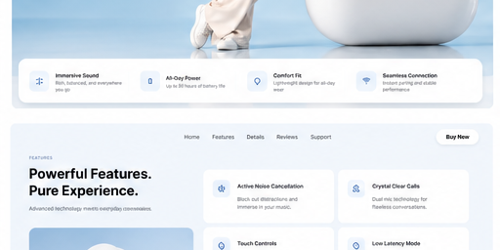
04 — Features

Slide 6
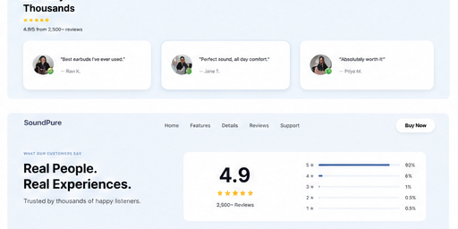
05 — Customer Reviews

Slide 7
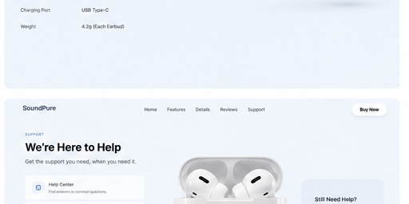
06 — Support

Slide 8
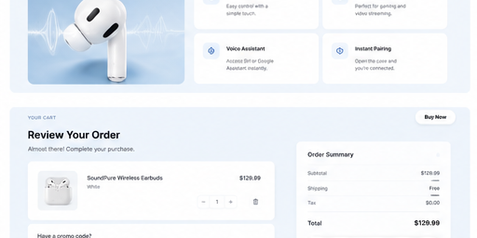
07 — Shopping Cart

Slide 9
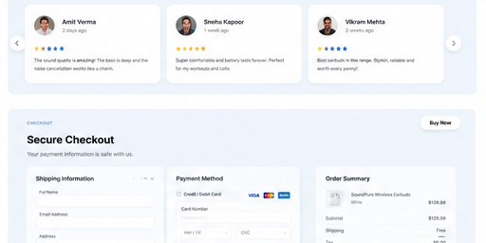
08 — Secure Checkout

Slide 10
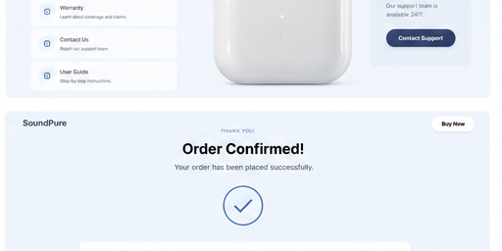
09 — Order Confirmation

Slide 11
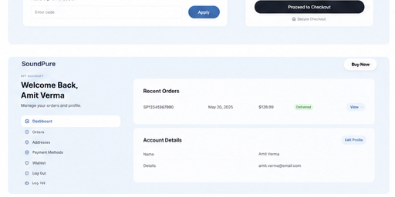
10 — Account Dashboard

Slide 12
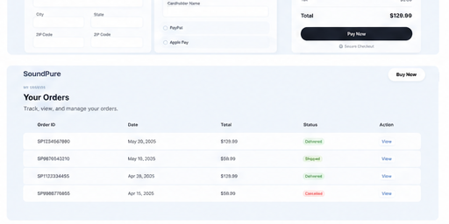
11 — Orders

Slide 13
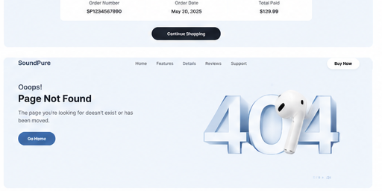
12 — 404 Page

